Slide 1
Module 5: Course Summary

Slide 2
Module Objectives
Review the steps for developing your emergency plan.
Step 1 – Knowing your hazards
Step 2 – Developing your plan
Step 3 – Testing and updating your plan
Locate resources to identify what your childcare site needs to do to be prepared.

Slide 3
Review: Module 1: Course Introduction
Identifying and addressing hazards.
Having a plan that addresses evacuating, staying put, and reunification.
Being able to contact parents/guardians and emergency personnel.
Establishing relationships with your community stakeholders and including them in your preparedness efforts.
Preparing your site.

Slide 4
Review: Module 2: Knowing Your Hazards
Fires
General Safety
Hazardous Materials
Utility Outages and Blackouts
Criminal Activity
Missing, Lost, or Abducted Child
Severe Weather and Geological Events
Illness Outbreaks
Food Safety
Building and Grounds Hazards

Slide 5
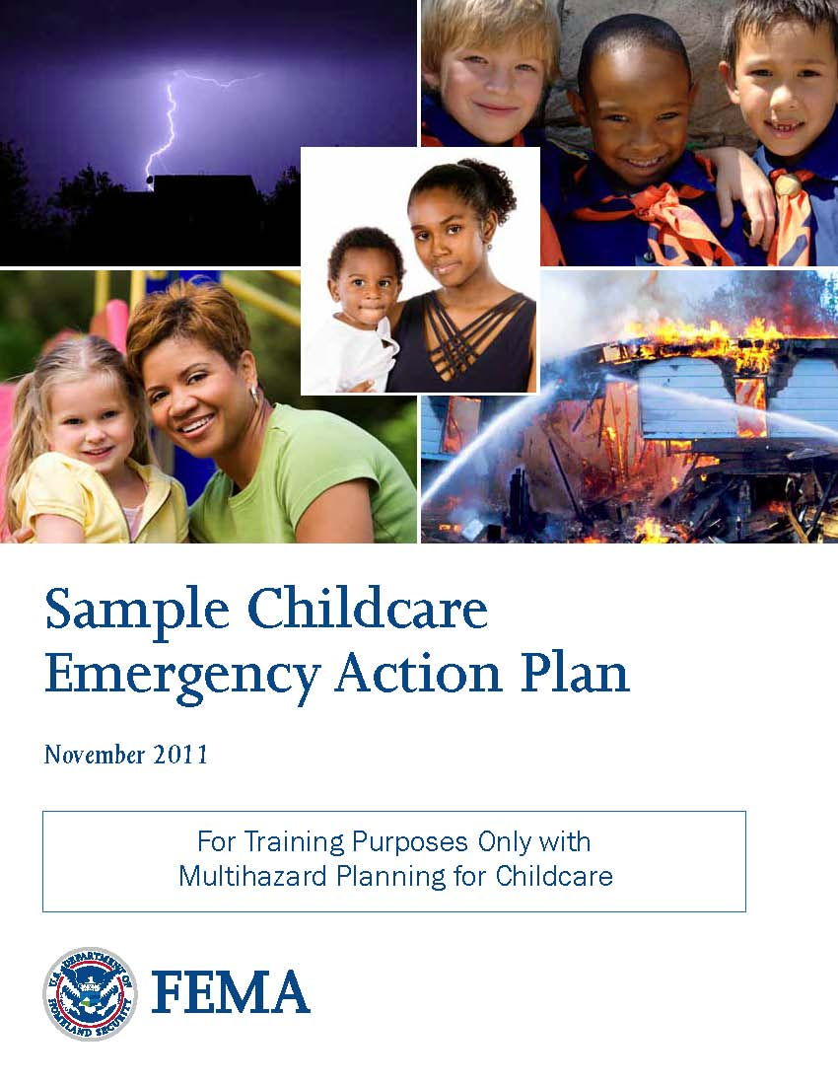
Review: Module 3: Developing Plans
Plan topics:
Collecting information.
Posting emergency information.
Developing procedures for:
Sign-in and sign-out.
Closing.
Shelter-in-place and evacuation.
Reunification.
Preparing emergency kits.
Accounting for different needs.

Slide 6
Review: Module 4: Testing and Updating Your Plan
Communicate the procedures in your plan.
Conduct and complete training to be prepared for emergencies.
Conduct drills to practice the procedures in your plan.

Slide 7
Next Steps
Develop your plan.
Test it through training and exercises.
Keep it updated.

Slide 8
Final Exam
Instructions:
Take a few moments to review your Student Manual and identify any questions.
Make sure that you get all of your questions answered prior to beginning the final test.
When taking the test . . .
Read each item carefully.
Enter the answers online.

Slide 9
Thank You
You now have been introduced to the simple steps you can take to ensure your childcare site is prepared.
Thank you for attending this course.

