Slide 1
Lesson 8: Application Activity
Lesson Objectives
At the end of this lesson, you should be able to apply key concepts in a scenario-based activity:
  NIMS Management Characteristics
  Incident Command and Unified Command
  Initial Size-up
  Developing Incident Objectives
  Determining Resource Requirements
  Determining Appropriate ICS Structure for an Incident
  Transfer of Command

Slide 2
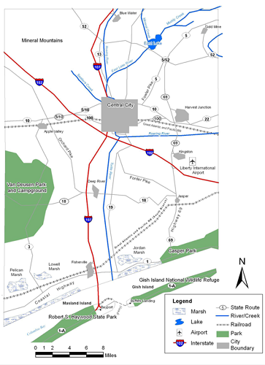
Scenario: Liberty County
Liberty County Map
The scenario for this activity takes place in Liberty County.
Liberty County is located in the fictional State of Columbia, on the Atlantic Coast between Canada and Mexico.
Liberty County is primarily rural with large tracts of forests, grazing lands and farmlands.
The population of the county is 302,412. Almost half of the population resides in Central City, and another quarter of the county’s permanent residents live in four smaller cities: Fisherville, Harvest Junction, Kingston and Bayport.
Liberty County government includes a Sheriff’s Department, Emergency Management Center, Public Health Department, Public Works Department and Board of Schools. The county infrastructure includes a dam and reservoir, a seaport and two airports.

Slide 3
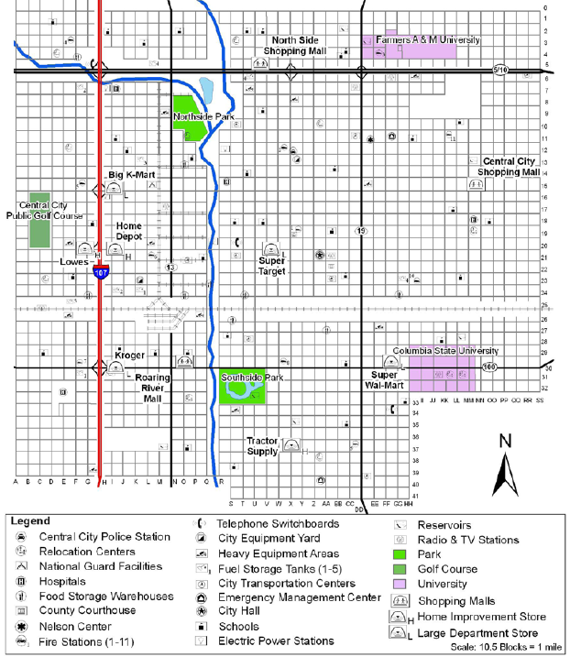
Central City
Central City is the county seat for Liberty County and houses a population of 149,000. It is a diverse city with industrial areas, commercial areas, multi-family housing complexes and single-family sub-divisions.
Central City government includes a Fire Department, Police Department, and Public Works Department. The city has a separate school district, four hospitals and two universities.

Slide 4
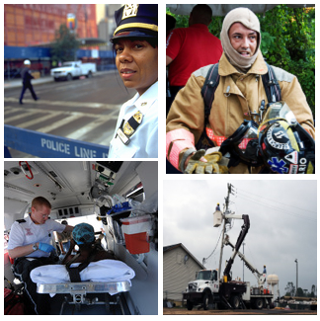
Your Role
You are a member of the emergency management community within Liberty County and Central City.
You could be from any of the many disciplines that could be involved in response to an incident, such as Fire, Police, Emergency Medical Services, Public Works, or Public Health. For the purposes of this activity, it is not important.
You are the first supervisory level person arriving on the scene of an incident. In this activity, you will apply what you have learned in this course to choose the appropriate initial response action that should occur.

Slide 5
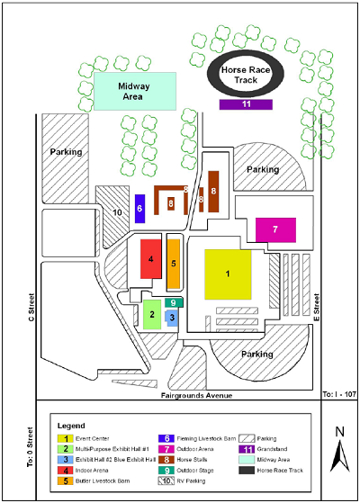
Liberty County Fairgrounds
The Liberty County Fairgrounds are located northwest of Central City. Fairgrounds Avenue, the southern boundary of the fairgrounds, is one street north of the city limits, within the jurisdiction of Liberty County.
The indoor and outdoor facilities at the Liberty County Fairgrounds are utilized throughout most of the year.

Slide 6

Liberty County Fair and Rodeo
It is the week of the annual Liberty County Fair and Rodeo. This event is hosted at the fairgrounds and attracts several thousands of visitors daily.
Early in the evening large crowds fill the 127-acre complex. People stream to and from the parking areas; traffic is congested; and the Midway area, outdoor stage, and Grandstand are filled to capacity.
Small elements of the County Sheriff’s office, the Central City Police Department, the Central City Fire Department, and County Emergency Medical Services (EMS) are located in and around the fairgrounds to provide for public safety at the event. These organizations are operating cooperatively, but no centralized incident command structure has been established.

Slide 7
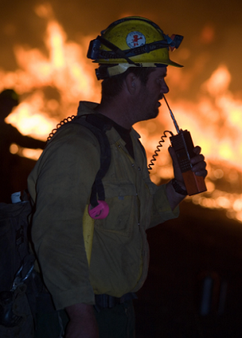
Tanker Truck Crash
At about 5 p.m. A large truck traveling fast heading west on Fairgrounds Avenue veers off the road, jumps the curb near the fairgrounds entrance, and passes through the crowd. The vehicle stops when it runs into an exhibit hall next to the outdoor stage. A few moments later, as the crowd begins to react, the large truck catches fire.
Several people were injured as the tanker truck passed through the crowd and there could be deaths. There is disorder as some attempt to flee and others try to help.
The large truck is an active fire that must be suppressed and could spread to nearby structures. There are other potential hazards including a damaged building and utilities (power, water, and gas) that could be damaged.
Public safety personnel on scene- law enforcement, fire, and EMS- respond immediately to the incident. Both the Central City and Liberty County Emergency Operations Centers are notified of these events and prepare to send any additional resources required for the incident.

Slide 8
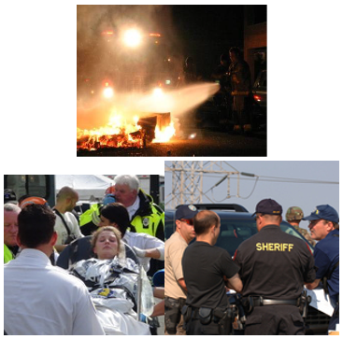
Establish Command
It is now approximately 5:15 pm. You are the first supervisor on scene and there is a need to quickly to establish Incident Command.
Let’s review a few of the NIMS Management Characteristics that apply to determining the best approach for the Incident Command function in an incident:
  Establishment and Transfer of Command - the first on scene need to explicitly establish incident or unified command and clearly state and record when command is transferred.
  Chain of Command and Unity of Command - all responders must be under a single command structure led by a designated Incident Commander (IC) or Unified Command (UC).
  Unified Command - if multiple organizations, disciplines, or jurisdictions are involved in the response, is a single IC sufficient, or is there a need for a unified command? UC is normally used for incidents involving multiple jurisdictions, a single jurisdiction with multiagency involvement, or multiple jurisdictions with multiagency involvement.

Slide 9
Activity 8.1: Establish Command
Activity Purpose: To apply key concepts regarding establishing command.
Time: 10 minutes
Instructions: Working with your team . . .
  Review the scenario on the previous screens.
  Consider the following - You are the first supervisor on scene - what type of incident command do you think is needed?
  Choose a spokesperson. Be prepared to present your answer to the class in 10 minutes.

Slide 10
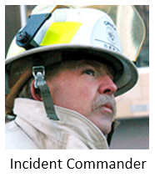
Establish Command (Continued)
You have established incident command under a single Incident Commander. This Incident Commander will be from the Central City Fire Department. Other jurisdictions and agencies involved in response to this incident will take their direction from this Incident Commander.
This conforms to the NIMS Management Characteristic of Chain of Command and Unity of Command – all responders are under a single command structure led by an Incident Commander.
Remember that the Incident Commander will manage the incident by establishing a common set of incident objectives for all jurisdictions and agencies involved in this response.

Slide 11
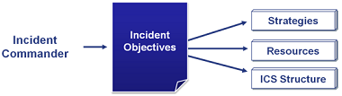
So, what is next?
Acting as the Incident Commander and determining your approach to the incident, your initial actions should include a Size-Up.
A size-up is done to develop initial incident objectives. Incident objectives will define what types of resources are required to respond to the incident. Finally, the resources the Incident Commander will manage affect which Command and General Staff positions will be activated to assist the IC in management of the incident.

Slide 12
So, what is next? (Continued)
The considerations for a size-up outlined in this course include:
  Size-up the nature and magnitude of the incident.
  Determine the hazards and safety concerns.
  Determine Initial Priorities and immediate Resource Requirements.
  Determine the location of the Incident Command Post and Staging Area.
  Determine the Entrance and Exit Routes for Responders.
Again, you will need to first complete your size-up activities to determine the ICS sections that you will need to manage the incident.
We will walk through these initial actions that you will take as the first supervisor on scene.

Slide 13
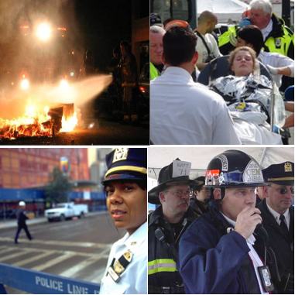
Size-Up the Nature and Magnitude
We will start size-up by looking at the first two considerations:
  Size-up the nature and magnitude of the incident
  Determine the hazards and safety concerns
Nature and magnitude refer to your assessment of what kind of incident you face. This can include the type of incident and the size and complexity of the event.

Slide 14

Discussion Question
What is the nature of the incident on the previous screen?

Slide 15

Incident Typing
You should recall from this course that a useful way of characterizing incidents is by incident typing.
Incidents are categorized into 5 types based on complexity. Type 5 incidents are the least complex and Type 1 incidents are the most complex.
Factors that impact the determination of incident type include size of the ICS structure, number of resources employed, and the length of time the incident response is anticipated to last.

Slide 16
Discussion Question
Review the following definitions of the Incident Type.
  TYPE 5 INCIDENT: One or two single response resources with up to 6 response personnel, Incident expected to last only a few hours, no ICS Command and General Staff positions activated.
  TYPE 4 INCIDENT: Several single response resources required, response will be limited to one operational period, select ICS Command and General Staff activated only as needed.
  TYPE 3 INCIDENT: Resource requirements will exceed the initial response resources, may extend into multiple operational periods, some or all ICS Command and General Staff are activated.
  TYPE 2 INCIDENT: Regional or National resources will be required, the incident will extend into multiple operational periods, most or all ICS Command and General Staff positions are filled.
  TYPE 1 INCIDENT: National level resources are required, the incident will extend into multiple operational periods, all ICS Command and General Staff positions are utilized, and Branches need to be established.

Slide 17
Discussion Question
What incident type is appropriate for the incident in this scenario?

Slide 18
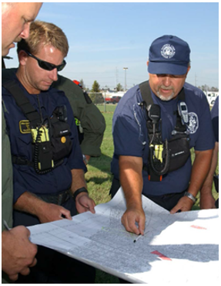
Hazards and Safety Concerns
Understanding that this is a Type 4 Incident should already give you a framework to understand the number of resources you will need, how long the response may take, and the need to establish some ICS Command and General Staff for the incident.
The next part of the Initial Response Activities is to determine the hazards and safety concerns in the incident.
Thinking through the hazards and safety concerns is an important exercise for the Incident Commander or Unified Command. You must define the problems that you face before you can determine and prioritize the actions that you need to take in response to the incident.

Slide 19
Activity 8.2: Hazards and Safety Concerns
Activity Purpose: To practice identifying hazards and safety concerns.
Time: 10 minutes
Instructions: Working with your team . . .
  Review the excerpt from the scenario below.
  Identify the hazards and safety concerns.
  Choose a spokesperson. Be prepared to present your answer to the class in 10 minutes.
Scenario:
Several people were injured as the large truck passed through the crowd and there may be deaths. There is disorder as some attempt to flee and others try to help. The tanker truck is an active fire that must be suppressed and could spread to nearby structures. The building and utilities (power, water, and gas) could be damaged and may present additional hazards to people in the affected area.

Slide 20
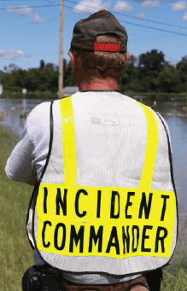
Determine Initial Priorities & Immediate Resource Requirements
Now that you have defined the nature and magnitude of the incident and understand the hazards and safety concerns that you are faced with, you can start determining priorities and resources.
Let’s start by reviewing two of the NIMS Management Characteristics that apply to determining priorities:
  Management by Objectives: Identify response priorities and objectives and define the resources required to achieve the objectives. This is a key activity that must be documented.
  Incident Action Planning: Incident objectives, tactics and assignments for operations and support are recorded and communicated through an Incident Action Plan (IAP). While this may not start as an extensive written document early in a response, as incidents increase in size, complexity, and length, it is increasingly important to document incident response activities.

Slide 21
Activity 8.3: Incident Objectives
Activity Purpose: To give the students practice at writing "SMART" incident objectives for various hazards and safety concerns.
Time: 15 minutes
Instructions: Working in your team:
  Review the Hazards and Safety concerns on the chart in your Student Manual.
  Using the chart included in your SM, determine what actions must be taken in response to the incident. Develop some simple objectives utilizing the "SMART" approach - incident objectives should be Specific, Measurable, Action-oriented, Realistic and Time-sensitive.
  List the "SMART" incident objectives on chart paper.
  Choose a spokesperson and be ready to present your objectives to the class in 15 minutes.

Slide 22
Discussion Question
You have a lot of objectives for this incident. You will be pursuing multiple objectives simultaneously, but you also need to understand the priority of your objectives.
Take a look at the incident objectives you developed, which do you assess as your top priority objective?

Slide 23
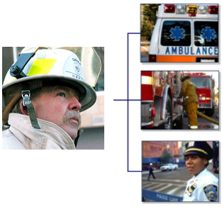
Determine Initial Priorities and Immediate Resource Requirements (Continued)
Once you have determined your objectives and priorities, you should next determine the resources that you will need to respond to the incident and accomplish your objectives.

Slide 24
Activity 8.4: Defining Resources
Activity Purpose: To allow students practice defining resources for Incident Objectives. Time: 10 minutes Instructions: Working in your team: Review the Incident Objectives you just created in the previous activity. Using the list of resources provided below, identify which resources you would need to accomplish your incident objectives. List the resources on chart paper. Choose a spokesperson and be ready to present your resources to the class in 10 minutes.
 | Resources: Fire Trucks with Firefighter Personnel Ambulances with Medical Personnel Hazmat Team Law Enforcement Traffic Control Law Enforcement Investigators Fire Investigators Medical Examiner / Coroner | Public Works - Electrical Public Works - Water Public Works - Gas Urban Search and Rescue Team Wildland Firefighting Teams K-9 Bomb Detection Dogs Explosive Ordnance Disposal Team

Slide 25
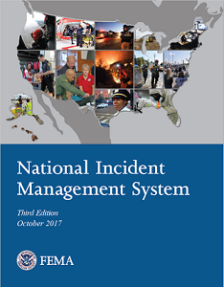
Determine Initial Priorities & Immediate Resource Requirements (Cont)
Before we move on from resources let’s review a few more NIMS Management Characteristics that can be applied to managing resources:
  Common Terminology: Using standard terms for resources can help to ensure that when you request a resource it meets your requirements.
  Accountability: You will need processes to record and report the status of all incident resources from the time they arrive on the incident until they are returned to their jurisdiction.
  Deployment: You will need to control deployment of resources to ensure that you receive only what you have requested. Unrequested resources can take up space needed for requested resources and can create additional management requirements on the Incident Command or Unified Command.

Slide 26
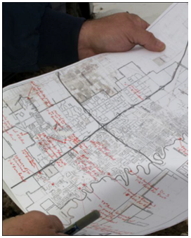
Determine Incident Locations
Congratulations, you have completed the first three initial response actions:
  Size-up the nature and magnitude of the incident
  Determine the hazards and safety concerns
  Determine initial priorities and immediate resource requirements
Next you have to consider a few issues associated with site control:
  Determine the location of the Incident Command Post and staging area
  Determine the entrance and exit routes for responders

Slide 27
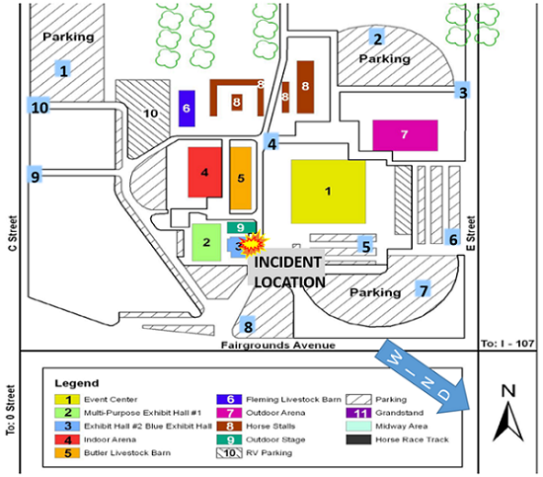
Activity 8.5: Determining Incident Locations
Activity Purpose: To give students an opportunity to practice determining incident locations
Time: 10 minutes
Instructions: Working in your team:
  Review the map and indicate where you would place the following incident locations:
    Incident Command Post
    Staging Area
    Entry point for responders
    Exit point for responders
  Choose a spokesperson and be ready to present your answers to the class in 10 minutes.

Slide 28
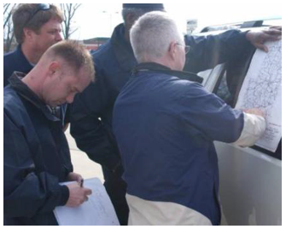
Establish an ICS Structure
Acting as the Incident Commander you have completed a size-up to include identifying hazards and safety issues, setting priorities, determining resources, and defining key initial incident management locations.
Now that you understand what you are trying to accomplish and what resources you will be managing, you will need to define the ICS structure that will be needed to support management of the incident.
At this point in the scenario, the Incident Command likely consists of the Fire Chief working over the hood of a command vehicle. Additional resources will be arriving soon and the Incident Commander will need additional staff personnel to help in the management in the incident response.

Slide 29
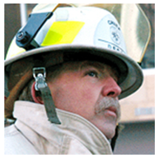
Establish an ICS Structure (Cont)
What ICS Command and General Staff positions will you need to manage the incident?
Remember that the Incident Commander/Unified Command is responsible for performing all of these functions personally until he or she activates that function.
  Incident Command
  Public Information
  Safety
  Liaison
  Operations
  Planning
  Logistics
  Finance/Administration

Slide 30
Establish an ICS Structure (Cont)
We previously assessed that this is a Type 4 Incident.
We expect several pieces of fire apparatus, ambulance crews, and law enforcement personnel to be involved. Between the incident site, the staging area, and the perimeter we can assume that at least 30 Law Enforcement, Fire, and EMS personnel will be involved in the incident response. These personnel will be distributed across at six to ten separate locations in and around the fairgrounds.

Slide 31
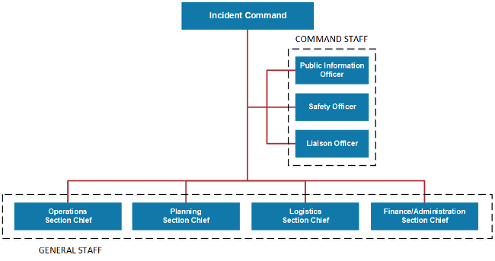
Establish an ICS Structure (Cont)
For the purposes of this activity, we will only look at the eight Command Staff and General Staff positions.

Slide 32
Establish an ICS Structure (Cont)
Recall what function each Command and General Staff position performs:
  Public Information Officer (PIO) interfaces with the public, media, and others needing incident information.
  Safety Officer monitors incident operations and advises the Incident Command on matters relating to health and safety.
  Liaison Officer serves as the Incident Command’s point of contact for organizations not included in the Unified Command.
  Operations Section plans and performs tactical activities to achieve the Incident Objectives established by the Incident Command.
  Planning Section personnel collect, evaluate, and disseminate incident information to the IC/UC and other incident personnel.
  Logistics Section personnel are responsible for providing services and support for the incident.
  IC/UC establishes a Finance/Administration Section when the incident management activities require on-scene or incident-specific finance and administrative support services.

Slide 33
Activity 8.6: Staff Selection Practice
Activity Purpose: To allow students an opportunity to analyze the incident and select the appropriate staffing.
Time: 10 minutes
Instructions: Working in your team:
  Review the scenario.
  Determine the staff required to manage this incident.
  Choose a spokesperson and be ready to present your answers to the class in 10 minutes.

Slide 34
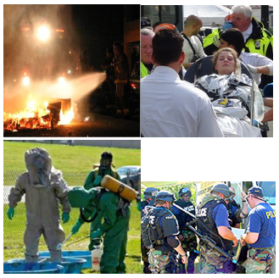
Scenario Part 2
It is now just after 6 p.m. and the situation appears to be getting worse.
The initial assessment of several injuries was incorrect. There are over a dozen injuries and at least three dead.
The vehicle fire spread quickly to the building, igniting a damaged natural gas line in a kitchen area. The combination of explosion, fire, and collision damage caused the building to partially collapse. The fire continues to burn and now threatens other surrounding structures.
The crowds are under control, but traffic has not yet completely cleared from the area and continues to slow the ingress and egress of emergency management resources.
The vehicle driver has not been found and the origin and contents of the large truck have not been identified. This raises new concerns that this could have been an intentional act and that the truck could have been transporting something hazardous.
This incident has increased in size and complexity and will extend into at least one more operational period.

Slide 35
Activity 8.7: Expanding Incident
Activity Purpose: To apply key concepts to analyze incidents.
Time: 10 minutes
Instructions: Working with your team . . .
  Based on the scenario update, review the factors that your instructor has assigned to you.
  Develop answers for each assigned factor.
  Choose a spokesperson. Be prepared to present your answers to the class in 10 minutes.

Slide 36
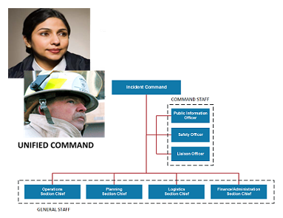
Transfer of Command
As the Incident Commander you make this assessment:
Incident Command: This is an incident that will now involve more jurisdictions and agencies. Law Enforcement is concerned with investigation and crime scene preservation, and Hazardous Materials (HazMat) assessment must be reconciled with your other priorities. A Unified Command with representatives from the various jurisdictions and agencies involved in response to this incident, to include Fire, EMS, Law Enforcement, and Public Works may now be the best approach for Incident Command.
Nature and magnitude of the incident: This is now a Type 3 Incident. Resource requirements will exceed the initial response resources you have on site, the incident will extend into multiple operational periods, and additional ICS Command and General Staff positions will have to be activated.
Hazards and safety concerns: The number of concerns has increased.
Priorities and resource requirements: While your current objectives are still valid, there will be additional objectives associated with law enforcement investigation, HazMat response, and Public Works actions that will require the development of new objectives. These objectives will have to be prioritized and additional resources will be needed to accomplish the objectives.
ICS structure: The ICS structure will need to be expanded. Liaisons, a Planning Section, a Logistics Section, and an Intelligence/Investigations function are some of the positions that should now be considered for inclusion in the Incident Command structure.

Slide 37
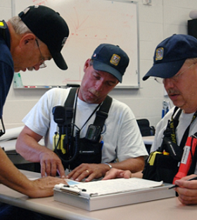
Transfer of Command (Continued)
The initial Incident Commander may continue to serve as a member of a Unified Command. It is also possible that the increase in complexity will lead to the appointment of more senior personnel to Incident Command.
Remember that Establishment and Transfer of Command is a NIMS Management Characteristic. You must clearly state and record when command is transferred.
The Transfer of Command should be conducted to create minimal disruption to the incident. Whenever possible, the Transfer of Command should include a complete briefing on the situation conducted face to face with the new Incident Commander or Unified Command.
The NIMS Management Characteristic Incident Action Planning also applies here. Incident objectives, tactics, and assignments for operations and support should be recorded and communicated through an Incident Action Plan (IAP). As your incident increased in size, complexity, and length, you should have started to document incident response activities in a written plan.
The ICS Form 201 is a standard format to record key situational information and document actions taken on an incident.

Slide 38
Lesson Summary
You have completed the Application Activity. You have applied these key concepts to a scenario-based activity:
  NIMS Management Characteristics
  Incident Command and Unified Command
  Initial Size-up
  Developing Incident Objectives
  Determining Resource Requirements
  Determining Appropriate ICS Structure for an Incident
  Transfer of Command

